Slide 1
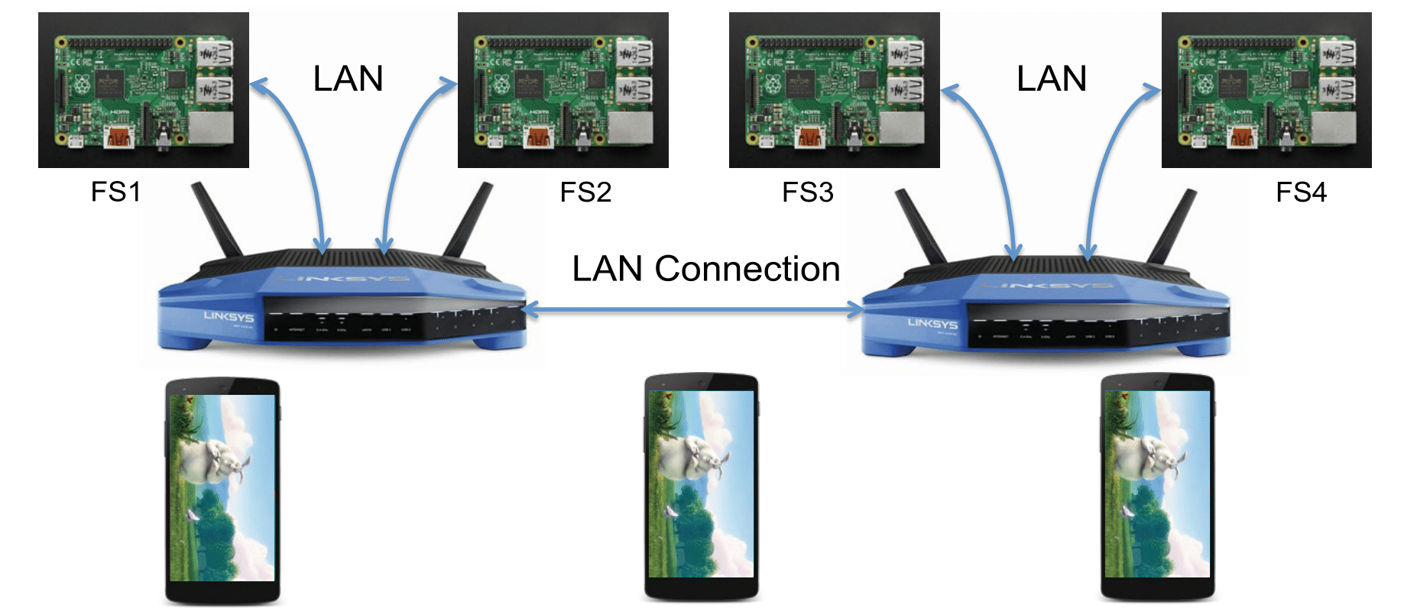
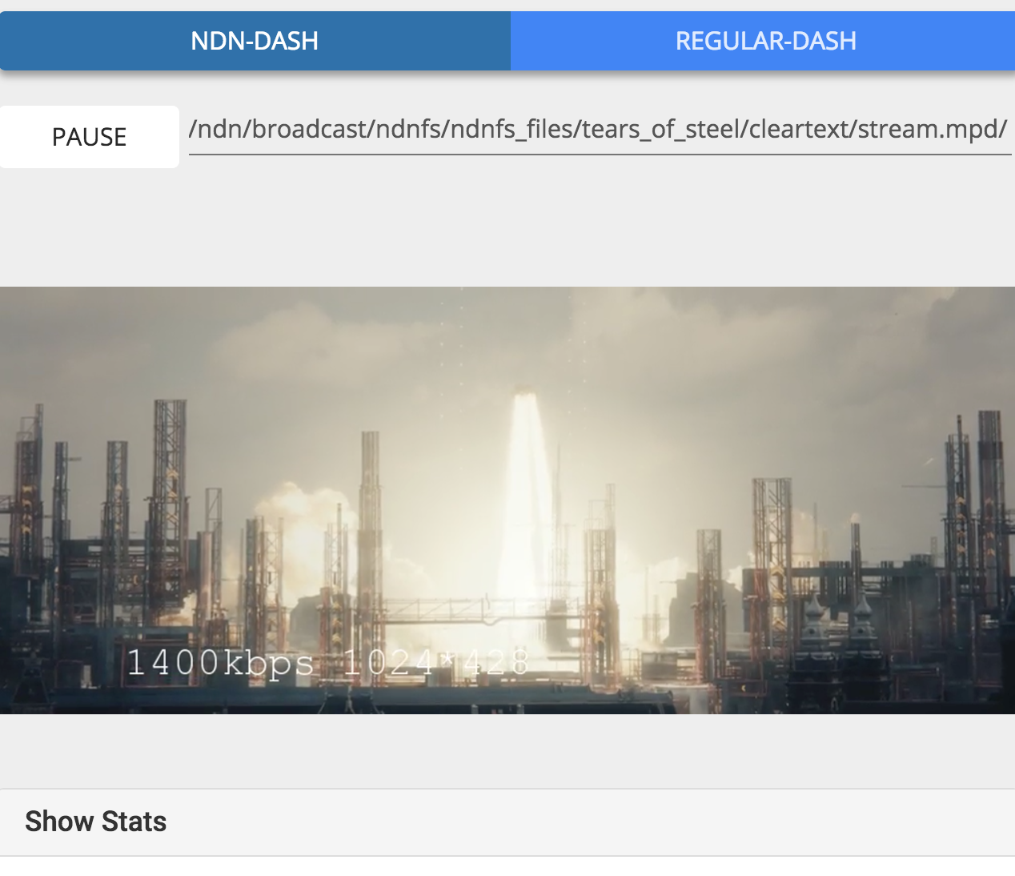
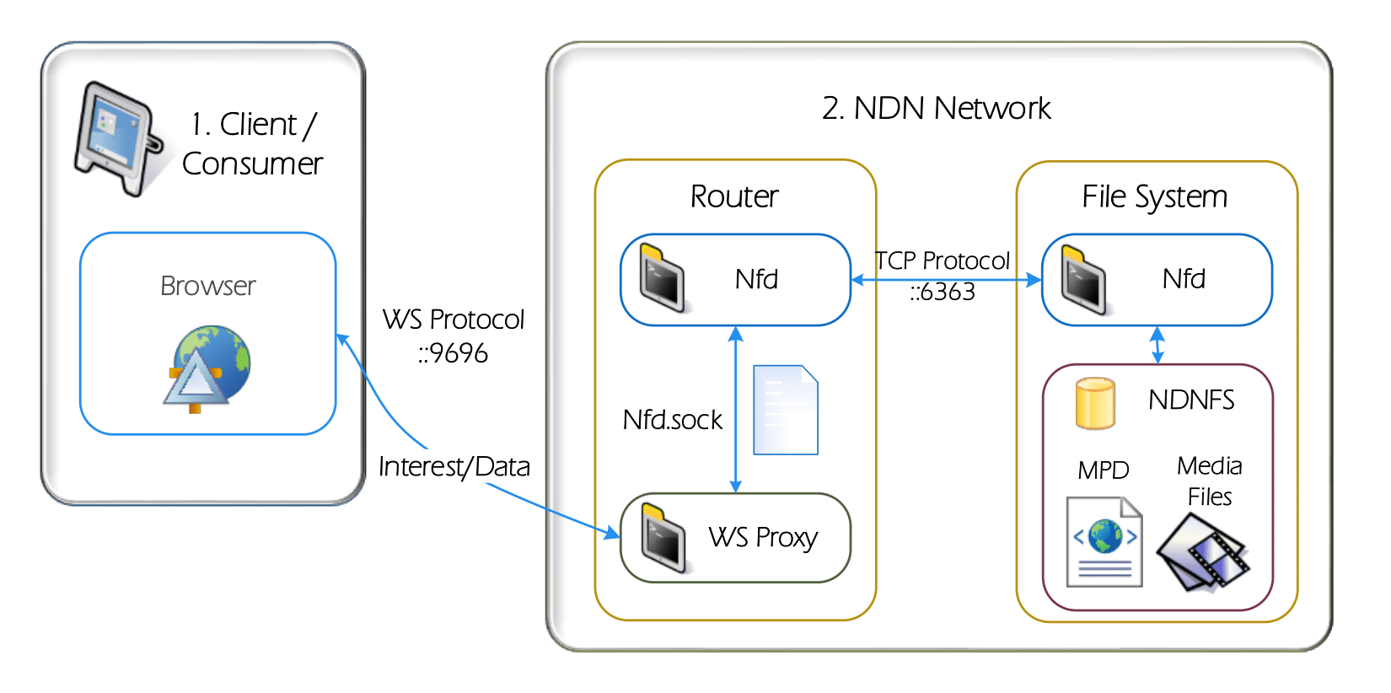
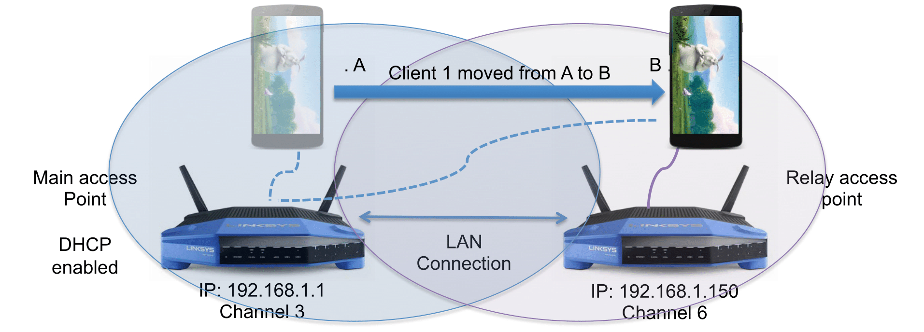
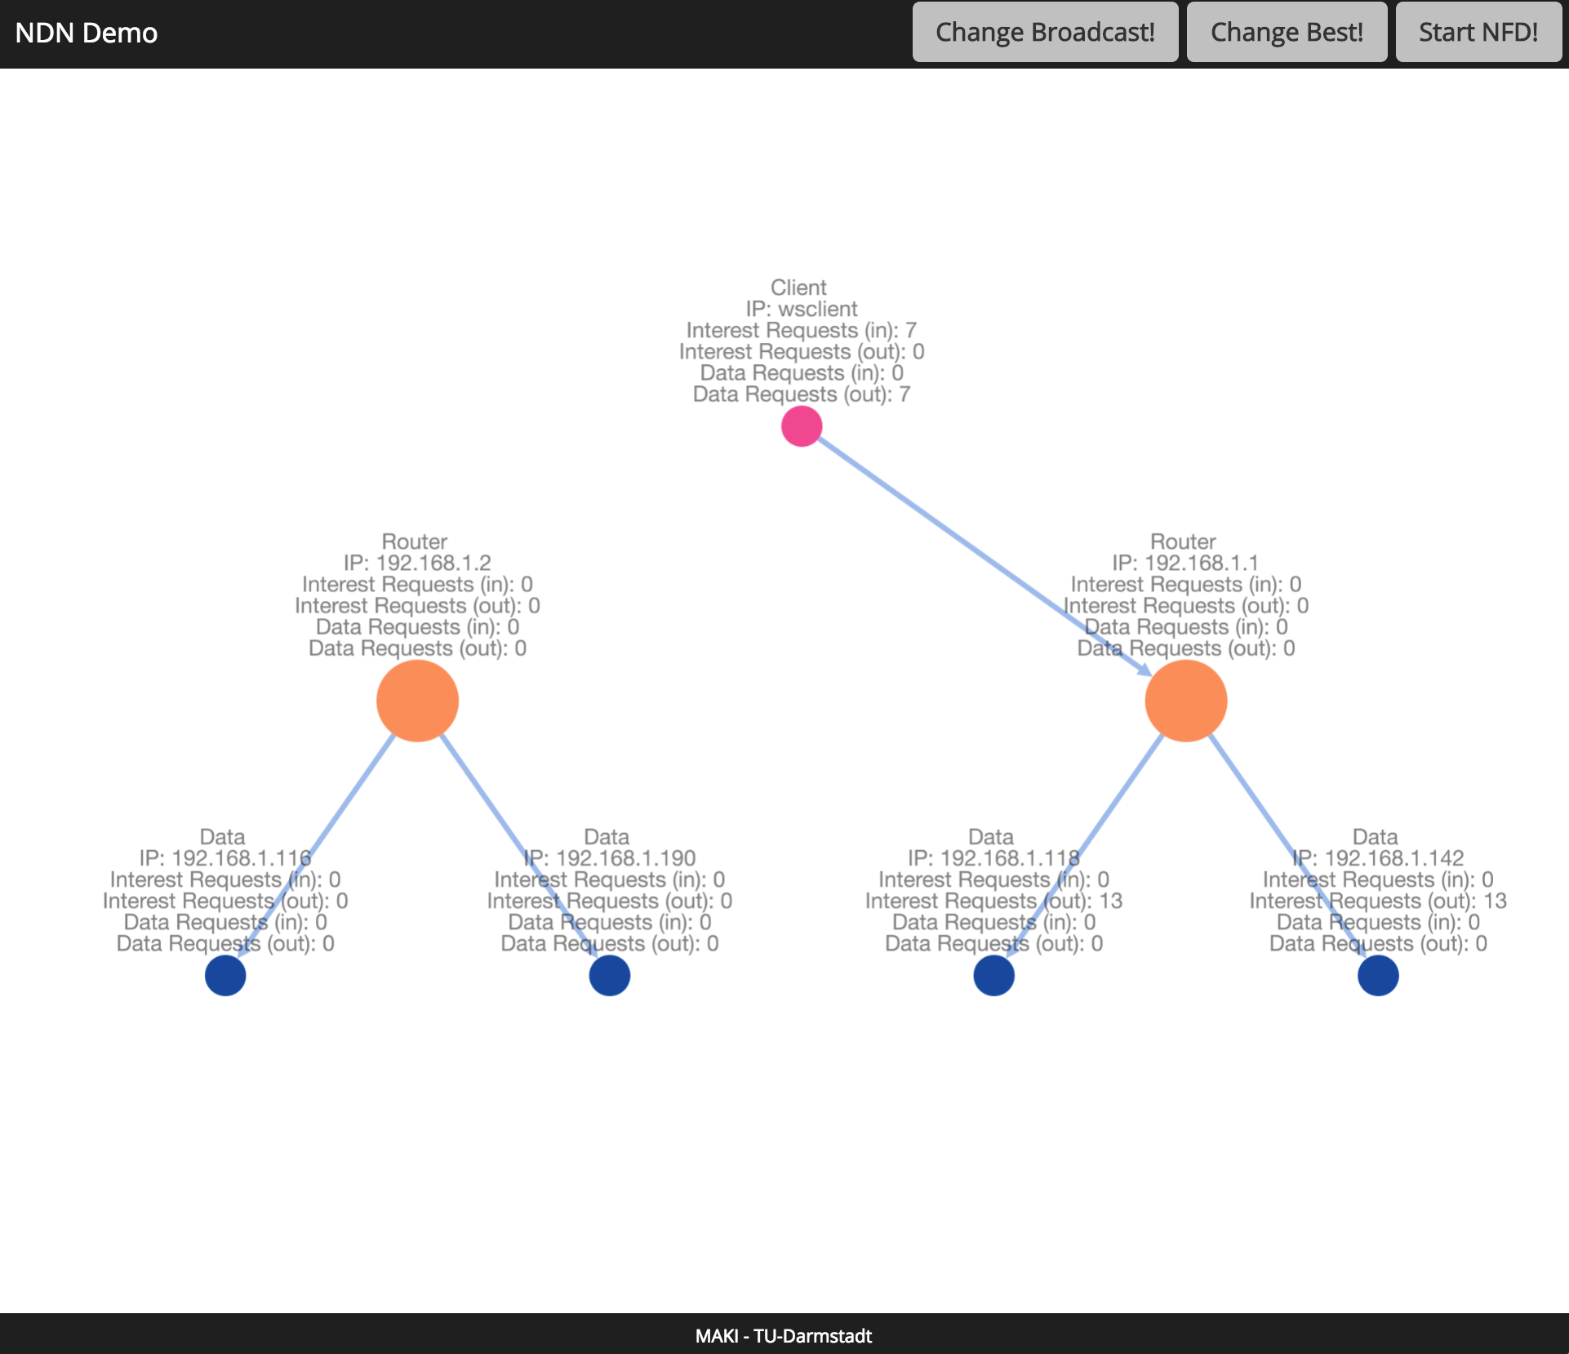


Mobile NDN-Based Dynamic Adaptive Streaming over HTTP (DASH)
Denny Stohr, Fares Beji, Rahul Dwarakanath, Ralf Steinmetz, Wolfgang Effelsberg; TU Darmstadt, Germany
Motivation
Testbed Architecture and Hardware
Global (mobile) video traffic rising exponentially [Cisco16]
Estimated to reach 82% of all consumer Internet traffic by 2020
Need for flexible and efficient distribution environments of video content
Named-Data Networking (NDN) for the Future Internet
Data-centric addressing with requests based on file names rather than host addresses [ZAB+14]
Interest packets issued by clients to request for data
Allows for higher tolerance towards client mobility and host failures through innovative routing and caching strategies
Better adaptivity to dynamic and changing environments compared to Content Delivery Networks (CDNs) [MCC+14]
NDN-enabled routers (LinkSys WRT-1200-AC)
Using custom-built OpenWRT
Hosting cross-compiled versions of NDN Forwarding Daemon (NFD)
NDN repositories based on Raspberry Pi’s (Model 2B)
Executes NFD for packet forwarding, and NDN-FS to serve as media file repository
Goals and Objectives
NDN-Based DASH Video Player
Goal 1: Developing an NDN-based testbed for mobile video
streaming using wireless access points and data storage units
Client-side DASH video player using JavaScript and HTML5 Media Source Extensions (HTML5-MSE)
Allows streaming of MPEG-DASH-compliant AVC-encoded content
NDN.js used for NDN support [STM+13]
Communication between clients and routers through WebSocket protocol
Goal 2: Achieving wide compatability with consumer devices by
employing web-based development concepts
Demonstration Objectives
Seamless playback of video streams
Showcase network resilience towards node failure
Execute client-based handover operations
Manage NDN routing strategies in the network (QoS-based)
Demonstrate the advantages and disadvantages of best-route and broadcast strategies
Compare NDN-based DASH to traditional DASH playback
DASH player request pipeline
User Interface
Visualization of current topology and NDN statistics
Change between forwarding strategies
Display of mobile Client WiFi Handovers
Future Work
I
Evaluation of NDN forwarding and caching strategies
II
Transfer of NDN functionality to user smartphones (Android)
III
Use of NDN for User-Generated Videos (UGVs)
References
Contact Details
[Cisco16] Cisco, “Cisco Visual Networking Index: Forecast and Methodology 2015-2020”, White paper, 2016, http://www.cisco.com/c/en/us/solutions/collateral/service-provider/visual-networking-index-vni/complete-white-paper-c11-481360.html [Last viewed: 03-11-2016]
[MCC+14] Ma, G., Chen, Z., Cao, J., Guo, Z., Jiang, Y., & Guo, X. “A Tentative Comparison on CDN and NDN” In IEEE SMC, 2014, pp. 2893-2898
[STC+13] Shang, W., Thompson, J., Cherkaoui, M., Burkey, J., & Zhang, L. “NDN. JS: A Javascript Client Library for Named Data Networking” In INFOCOM WKSHPS, 2013, pp. 399-404
[ZAB+14] Zhang, L., Afanasyev, A., Burke, J., Jacobson, V., et al. “Named Data Networking” ACM SIGCOMM Computer Communication Review, 44(3), 66-73, 2014
Denny Stohr
DMS, Technische Universität Darmstadt
dstohr@kom.tu-darmstadt.de
Rahul Dwarakanath
KOM, Technische Universität Darmstadt
dwarakan@kom.tu-darmstadt.de

